Slide 1
Welcome to
St Peter’s C.E
Primary School
School Uniform
Boys uniform
‌
Black shorts or trousers
Short sleeved white shirt
Green & silver striped St. Peter's tie
Green & silver V-neck knitted jumper with the school crest
Black socks
Black shoes
Girls uniform
‌
Black skirt or pinafore dress
Short sleeved white shirt
Green & silver striped St. Peter's tie
Green & silver V-neck knitted cardigan or jumper with the school crest
White or black socks
Green or black hair accessories
Summer term only - green gingham dress
Physical Education (P.E.) Kit for boys and girls
Black shorts
White Polo shirt with or without the school crest
Black pumps
Trainers are allowed for outdoor games only.
All earrings must be removed for P.E. If your child cannot remove their own earrings then please ensure that they come to school the day of their P.E. lesson not wearing their earrings.
All Reception children must have a pair of wellies to be kept in school.
All uniform must be clearly labelled.

Slide 2
Starting
School
St. Peter’s C.E Primary School 2021/22

Slide 3
St Peter’s CE School
Reception 2021/22
Maple Class |  | Oak Class
Group A Kian D Charlie A Carter B Theo C Prestyn D Edie F Holly H Jensen M Oscar S Shae S Winter-Snow H-J |  | Group A Archie K Alex A Noah A Hollie-Mae H Oliver H Myley-Rose M Violet S
Group B Hadley T Rianna T Tommy Myla L Samuel T Bobby W Leo W Jan W Huxlee-James W Shauna W Bradley R |  | Group B Percival L Valentino C Logan D-N Zoe S Martha W Oscar M
Pre school visits
Visit
Thursday 2nd July: Group A: 1.30pm - 2.30pm
Visit
Wednesday 1st July: Group B: 9.30am - 10.30pm

Slide 4
Pre school visits
Visit
Thursday 8th July: Group A: 9.30am—10.30am
Visit
Friday 9th July : Group B 9.30am—10.30am
Due to current restrictions you will not be able to stay in school during this time.
If you would like to speak to a member of staff, including the SENCO or Well-being Co-ordinator. Please contact school to make an appointment on 01254 701299.

Slide 5
St Peter’s CE School
Reception 2021/22
Thursday 2nd September | Group A 8.55 am-11.30 am | Group B 1.05 pm-3.30 pm
Friday 3rd September | Group A 8.55 am-11.30 am | Group B 1.05 pm-3.30 pm
Week Commencing 6th September | All children full time 8.55 am—3.30 pm

Slide 6
School Uniform

Slide 7
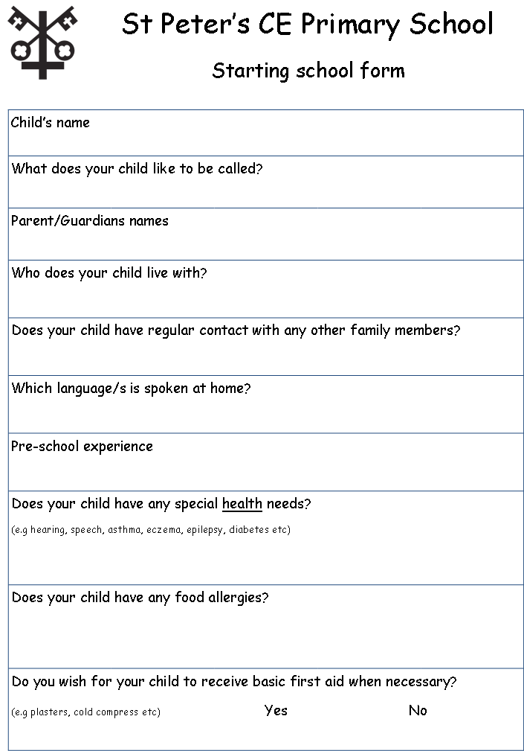
Please return to school before Friday 9th July 2021

Slide 8
Tour around the School
Date: 14th June 2021
Due to current restrictions only 1 parent may attend.
This is only for parents to attend, your child has been given a separate time to visit
 | Group 1 | Group 2
3.45-4.15pm | Kian D Charlie A Carter B Theo C Prestyn D Edie F | Archie K Alex A Noah A Hollie-Mae H Oliver H Myley-Rose M
4.30 -5pm | Holly H Jensen M Oscar S Shae S Winter-Snow H-J Hadley T | Violet S Percival L Valentino C Logan D-N Zoe S Martha W
5.15-5.45pm | Rianna T Tommy T Myla L Samuel T Bobby W Leo W | Oscar M Jan W Huxlee-James W Shauna W Bradley R

Slide 9
School Nursing
Within your new starters pack you will have received a health needs assessment questionnaire.
Health questionnaires are completed at key times in a child’s schooling:
For parents to complete prior to reception
For year 6 children to complete in school electronically
For year 9 children to complete in school electronically
These opportunities help us to direct our support where it’s needed at key points of transition, so returning you questionnaire prior to starting school will allow us to review the information you have shared and support with school readiness.
We can support with behaviour, toileting, night time wetting, vision/hearing, understanding how to protect your child with vaccines, home/ car safety or
Devise health care plans for children with medical needs in partnership with parents and school.
We also carry out training in schools to help staff manage the needs of children with additional needs (asthma, anaphylaxis, epilepsy, eczema).
Please can you return the questionnaire to school as soon as possible to enable us to offer support as soon as possible.
How to get in touch:
Tel: 01254 585000 Option 2 then the area of Blackburn you live in. If you are not sure choose any and we will direct you to the right team.

Slide 11
St Peter’s
a b c d e f g h i j k l m n o p q r s t u v w x y z
All letters start on the line with an entry stroke and end with an exit stroke.
You will find a name card for your child in their bag.

